Slide 1

Graph Algorithms
Welcome to the world of graphs – a tale of nodes, edges, and algorithms that rule the digital world!

Slide 2
What is a Graph?
Definition:
A graph is an ordered pair G = (V, E) where:
V is a finite set of elements called vertices or nodes.
E is a finite set of edges, where each edge is a pair of vertices from V.

Slide 3
Types of Graphs
Undirected, Directed, Weighted, Unweighte, Sparse, Dense

Slide 4
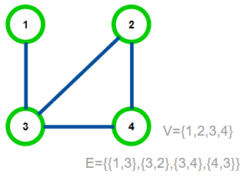
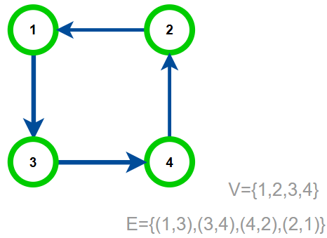
Directed and Undirected Graphs
An undirected graph is a graph G=(V,E), where the edges E are unordered pairs.
In a directed graph is a graph G=(V,E), where the edges E are ordered pairs.

Slide 5
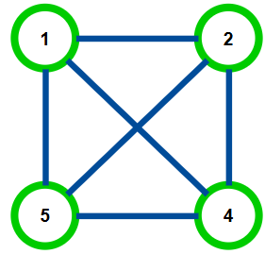
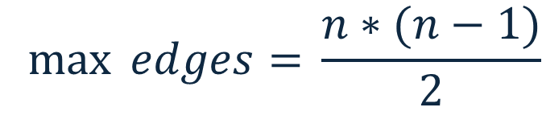
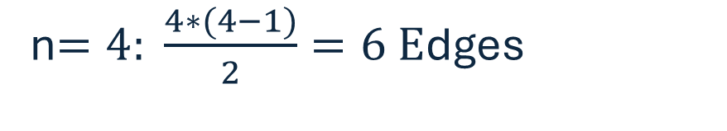
Dense and Sparse Graphs
Dense:
Number of edges ≈ Max number of Edges
What‘s the maximum number of edges that a graph on n nodes can have?
Graphs with Θ(n²) edges are called dense
$$\max{ edges= }\frac{n∗(n−1)}{2}$$
Sparse:
-> Θ(n²)
Number of edges << Max number of Edges
Graphs with O(n) edges are called sparse
n$=4: \frac{4∗(4−1)}{2}=6 E$dges

Slide 6
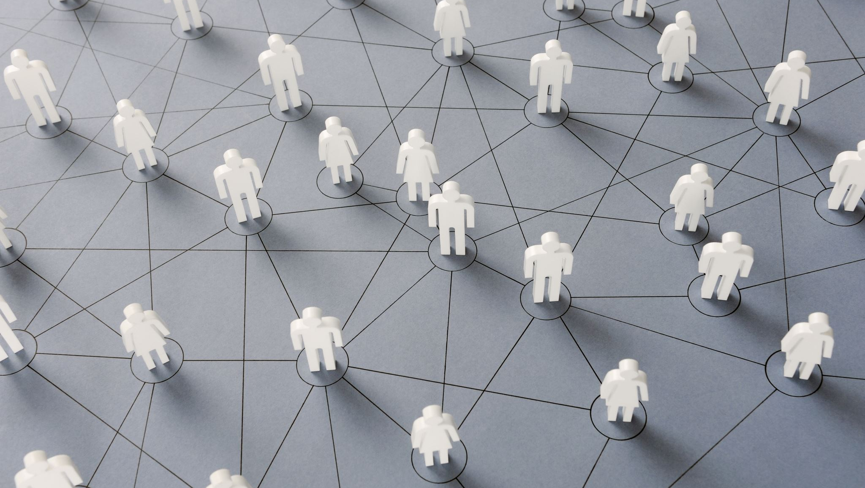
Real World Example
Social Networks are typically Sparse

Slide 7

Real World Example
Computer Networks are typically Dense

Slide 8
Graph Representation
How do we store a graph on a computer?

Slide 9
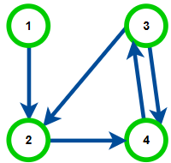
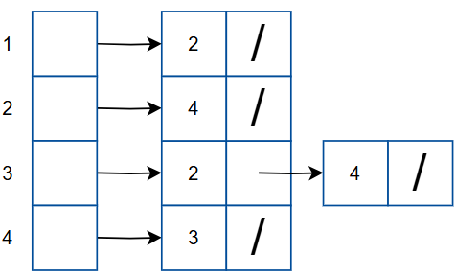
Representation: Adjacency List/Array
For every node we store all of its neighbors in a Sequence data structure (i.e. list or array)
(possibly in sorted order)
Space usage:
O(|V|+|E|)
Adjacency Array is the standard representation!

Slide 10
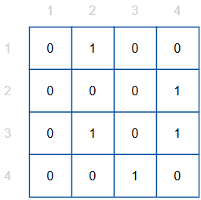
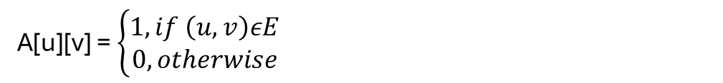
Representation: Adjacency Matrix
A[u][v] = $\left\{\begin{aligned}1, if \left(u,v\right)εE \\ 0, otherwise\end{aligned}\right.$
Store a matrix A[1. . |V|] [1. . |V|] where:
(= 2-dimensional array)
On Dense Graphs:
Θ(|V|²)=Θ(|E|)
Space usage:
Θ(|V|²)
Is very efficient on dense graphs, but only on dense graphs!

Slide 11
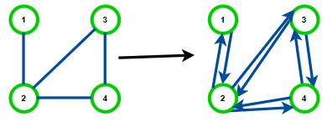
Representation: Undirected Graphs
To represent an undirected graph, we instead represent its bidirectional version:
→All representations can be easily adapted

Slide 12
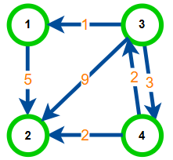
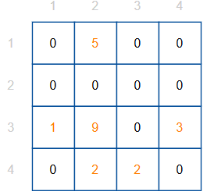
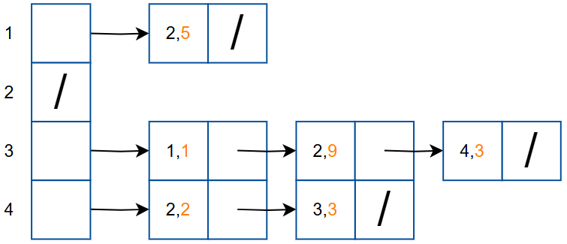
Representation: Edge Weights
Sometimes we want to associate auxiliary information at the edges
E.g. if edges are roads we want to store their length
E.g. if edges are cables we want to store their maximum throughput
…
Weighted graph: graph G = (V,E) and weight function w: E → ℤ
→All representations can be easily adapted to store edge weights

Slide 13
Graphs are used in a wide range of fields to model relationships and interactions between entities. Some key areas where graphs are used:
Graphs are everywhere!

Slide 14

Applications in Biology & Medicine
Genomics: Sequence assembly graphs, gene interaction networks.
Neural networks in neuroscience: Neurons as nodes, synapses as edges.
Disease spread models: People or regions as nodes, transmission paths as edges.

Slide 15

Transportation & Logistics
GPS and route finding: Cities/intersections as nodes, roads as edges.
Airline networks: Airports as nodes, flights as edges.

Slide 16
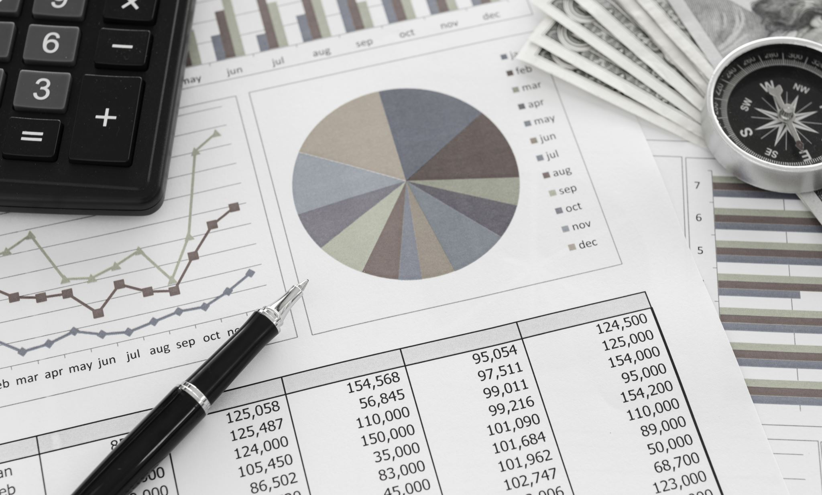
Finance
Transaction networks: Accounts as nodes, transactions as edges (used in fraud detection).
Market modeling: Dependencies between stocks or assets.

Slide 17

Data Science & Machine Learning
Knowledge graphs: Represent relationships between entities (e.g., in semantic search).
Graph neural networks (GNNs): Learning on graph-structured data.
Recommendation systems: Users and items as nodes; edges represent interactions.

Slide 18

Computer Science
Social networks: Users as nodes, friendships/follows as edges.
Web page linking: Web pages as nodes, hyperlinks as directed edges.
Routing and navigation: Locations as nodes, roads as weighted edges.

Slide 19
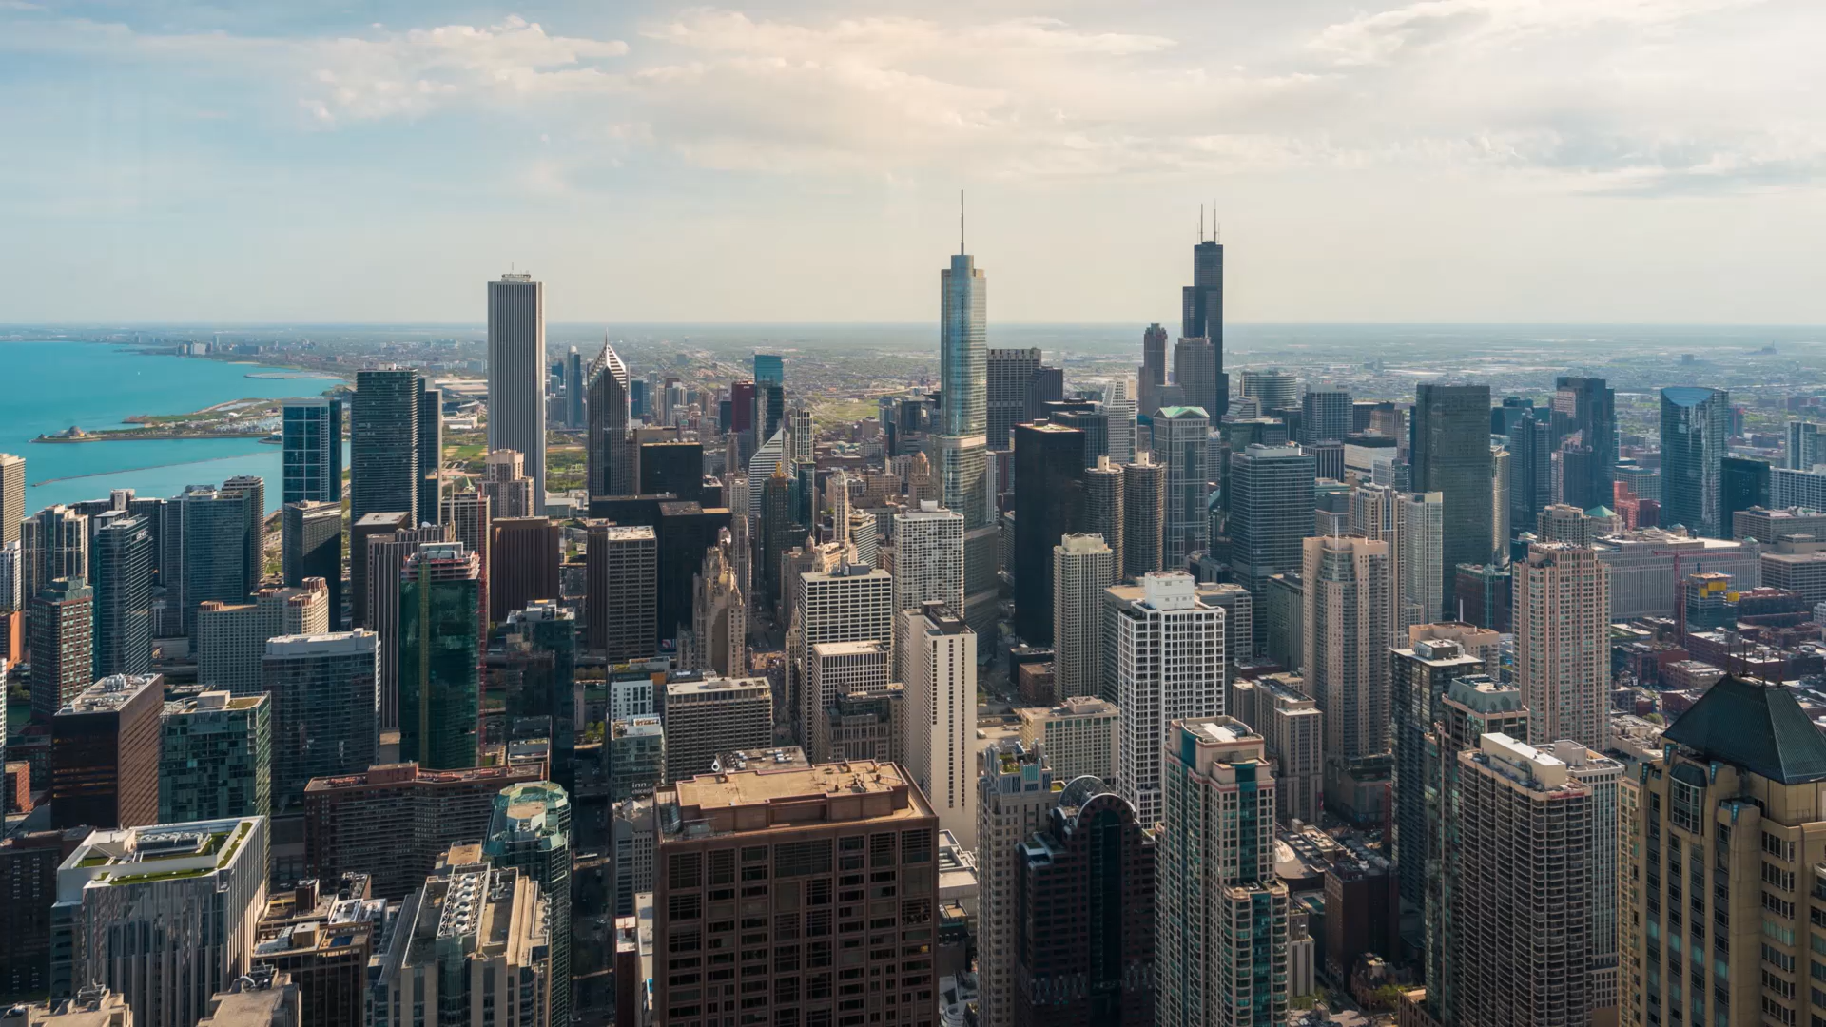
Google Maps Uses Graphs
Shortest path algorithms help you get from point A to B efficiently.

Slide 20
Famous Algorithm: Dijkstra’s Shortest Path
Developed in 1956 by Edsger Dijkstra. Finds the shortest path from a source node to all others in a weighted graph.

Slide 21
How Dijkstra’s Works
Uses a greedy strategy. Repeatedly picks the closest unvisited node and updates distances to its neighbors.

Slide 22
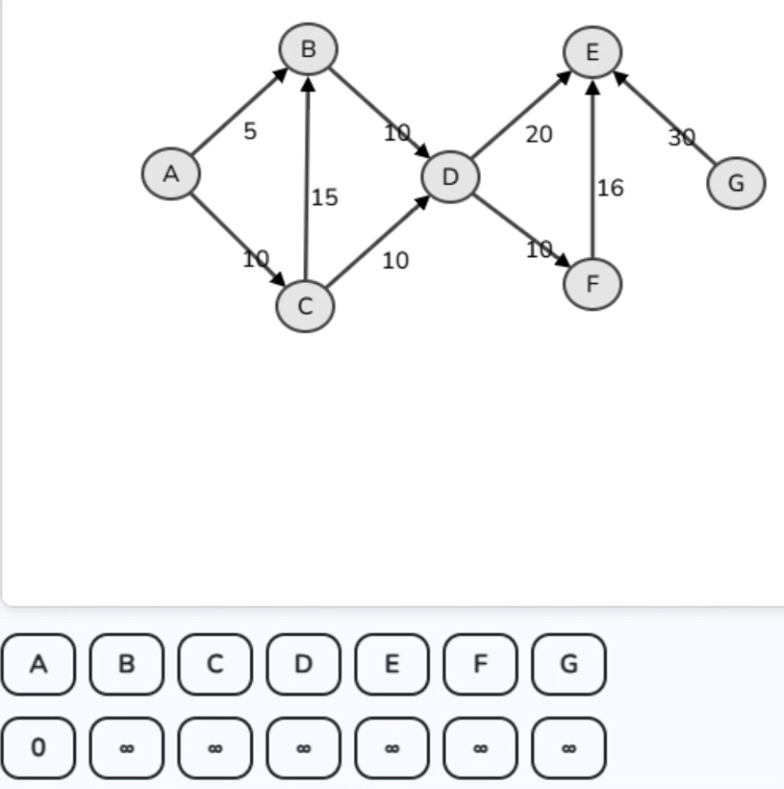
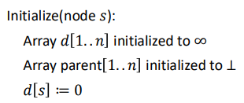
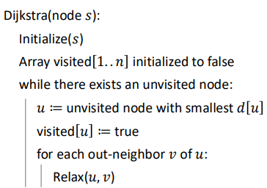
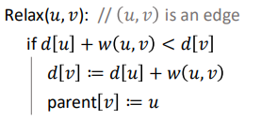
How Dijkstra’s Works
Uses a greedy strategy. Repeatedly picks the closest unvisited node and updates distances to its neighbors.

Slide 23
How Dijkstra’s Works
We maintain a Dictionary storing for each unvisited node 𝑣 an item(𝑑[𝑣],𝑣), compared lexicographically
when visiting node 𝑣 we remove the item(𝑑[𝑣], 𝑣) from the dictionary
when relaxing edge (𝑢, 𝑣) we remove the old item(𝑑[𝑣], 𝑣) and then insert a new item(𝑑[𝑣], 𝑣) with a new value 𝑑[𝑣]
to determine the unvisited node with smallest 𝑑[𝑢] we compute the smallest item in the dictionary, i.e. we run min()
Since each node is visited at most once and thus each edge is relaxed at most once, the total running time is 𝑂((|V|*(min)+|E|)*(remove+insert))
Priority Queue as a linear array:
O(|V|²+|E|) = O(|V|²)
Priority Queue with a binary heap:
O((|V|+|E|)*log(|V|))
Priority Queue with a Fibbonacci heap:
O(|V|*log(|V|+|E|))

Slide 24

Fun Fact: Dijkstra Didn’t Use Computers!
He devised his algorithm while on vacation in Switzerland – without pen or paper!

Slide 25

Thanks & Questions!
Explore further: Attend the lecture ‘Introduction to Algorithms and Data Structures’, read 'Introduction to Algorithms by Cormen, Keiserson & Rivest’ and try coding some algorithms!

